Slide 1

Fuzzy Sets and Systems I
Optimizing Travel Paths: Fuzzy Logic Systems For Tailored Destination Recommendations
Simon Parris
Vedasri Nakka
Michèle Fischer
University of Fribourg
22 Dec 2023

Slide 2
Table of Contents
Concept
Architecture
Prototype
Fuzzy Logic
Results
Demo

Slide 3
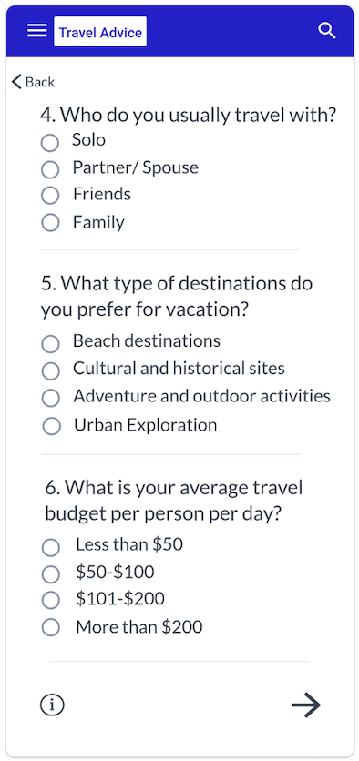

Concept
The main idea behind this project is to use fuzzy logic technology to recommend a customized travel destination to users by analyzing their responses.
The user will engage with the travel advice application and provide their travel preferences to the system.
Based on user feedback, our designed fuzzy logic will recommend a location.
To make these recommendations, we will leverage accessible data on tourist trends, destination popularity, and user feedback.

Slide 4
Architecture
Fuzzification
Fuzzy rules
Defuzzification
Profile generation
Decision making
Recommended Travel destination
Web interface
Taking survey
Input
Data Acquisition
Storage
Output

Slide 5
User/Fuzzy profile

Slide 6
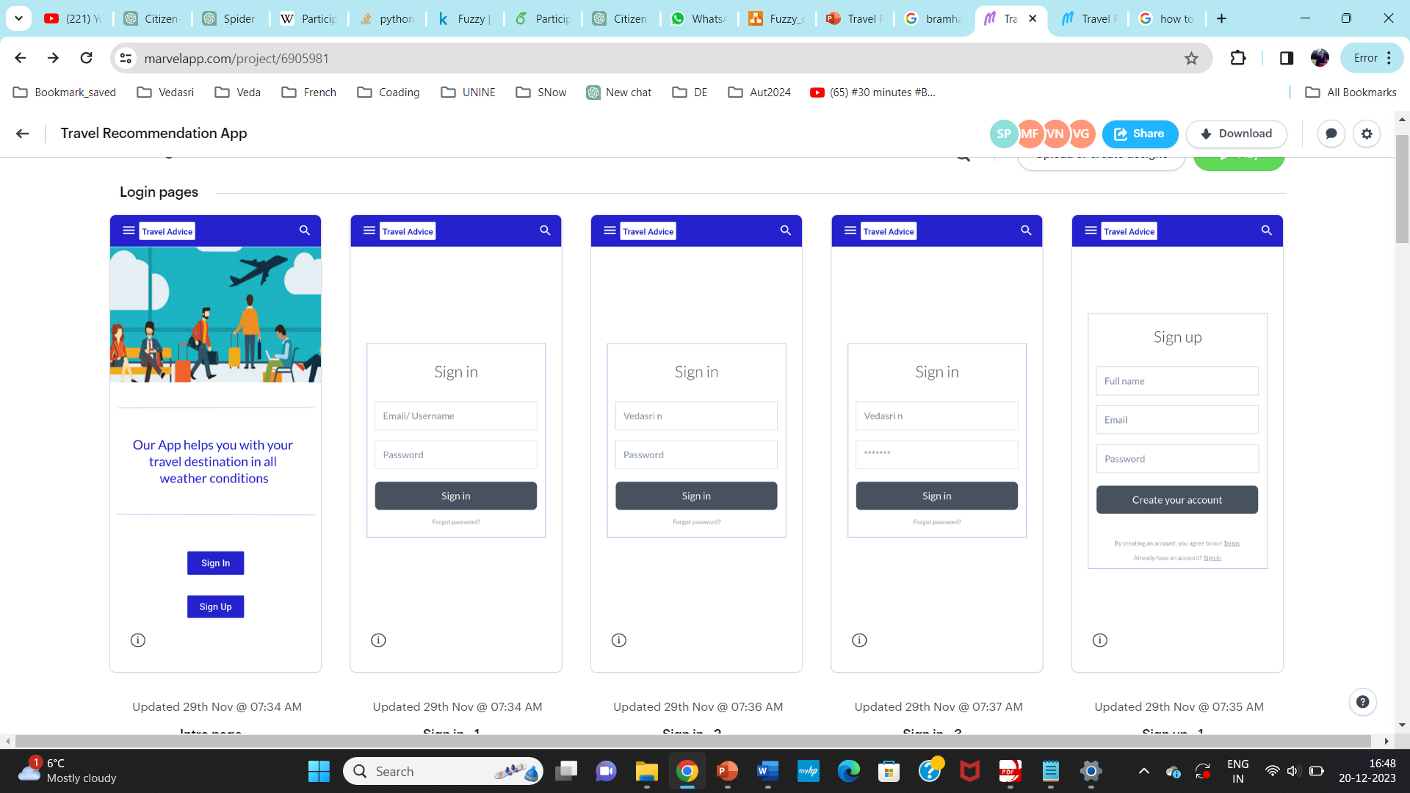

Slide 7
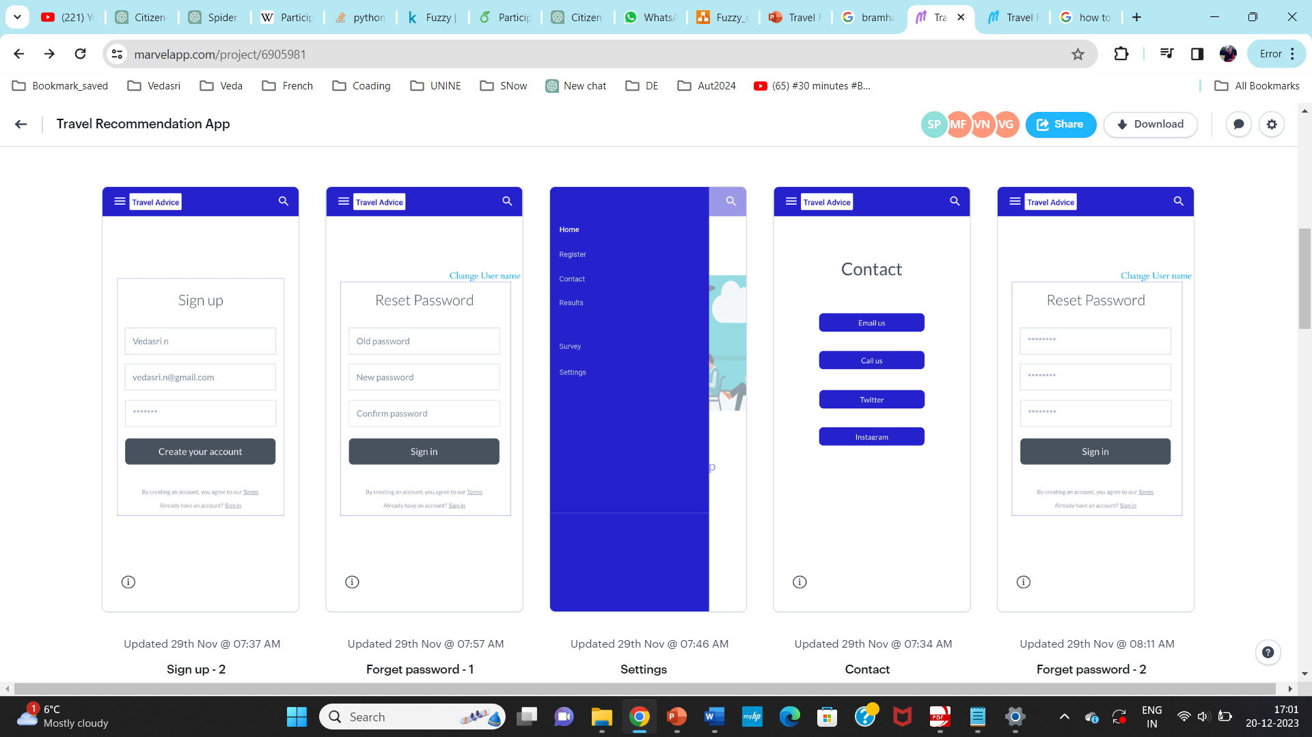
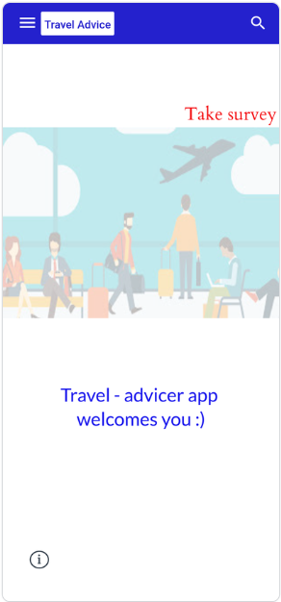

Slide 8
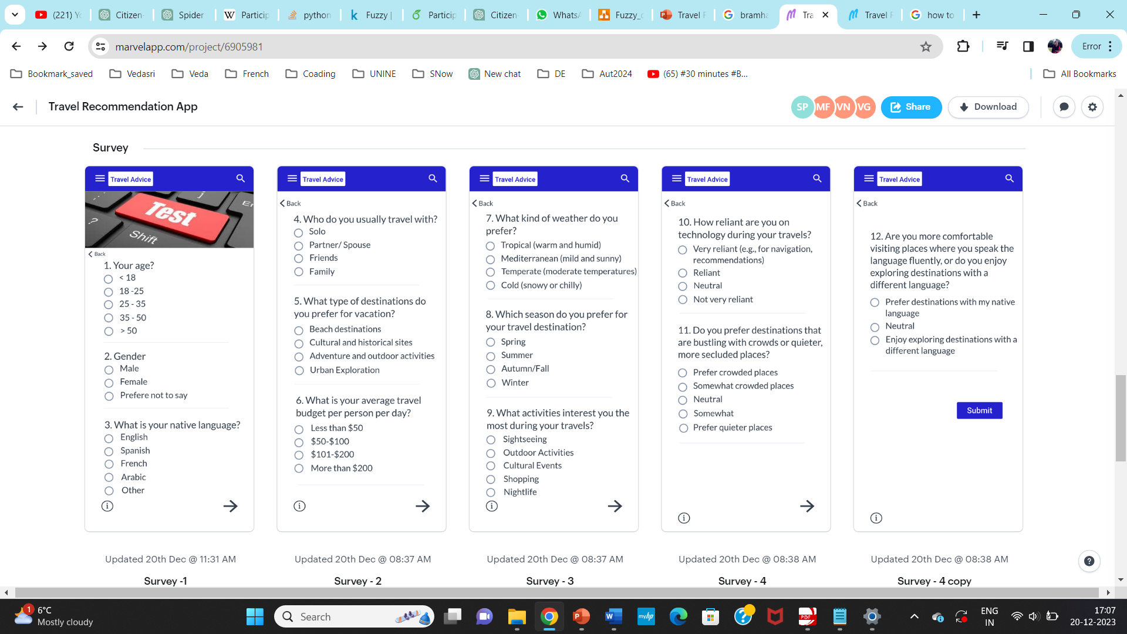

Slide 9

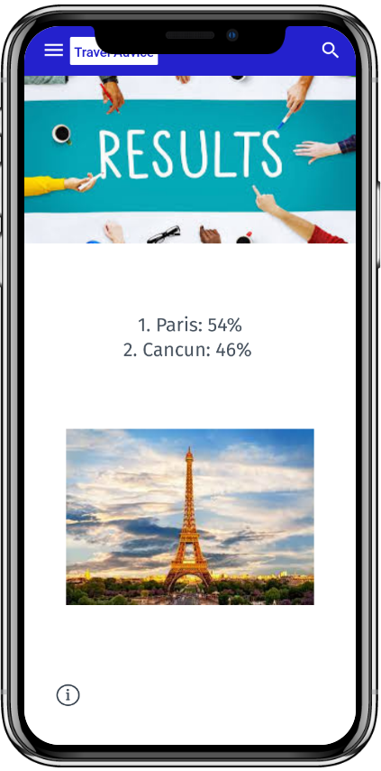

Slide 10
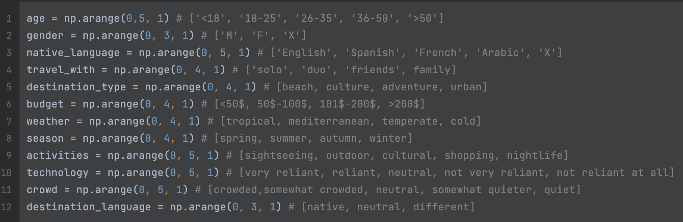
Defining the features
To implement fuzzy logic we used the SciKit-Fuzzy package

Slide 11
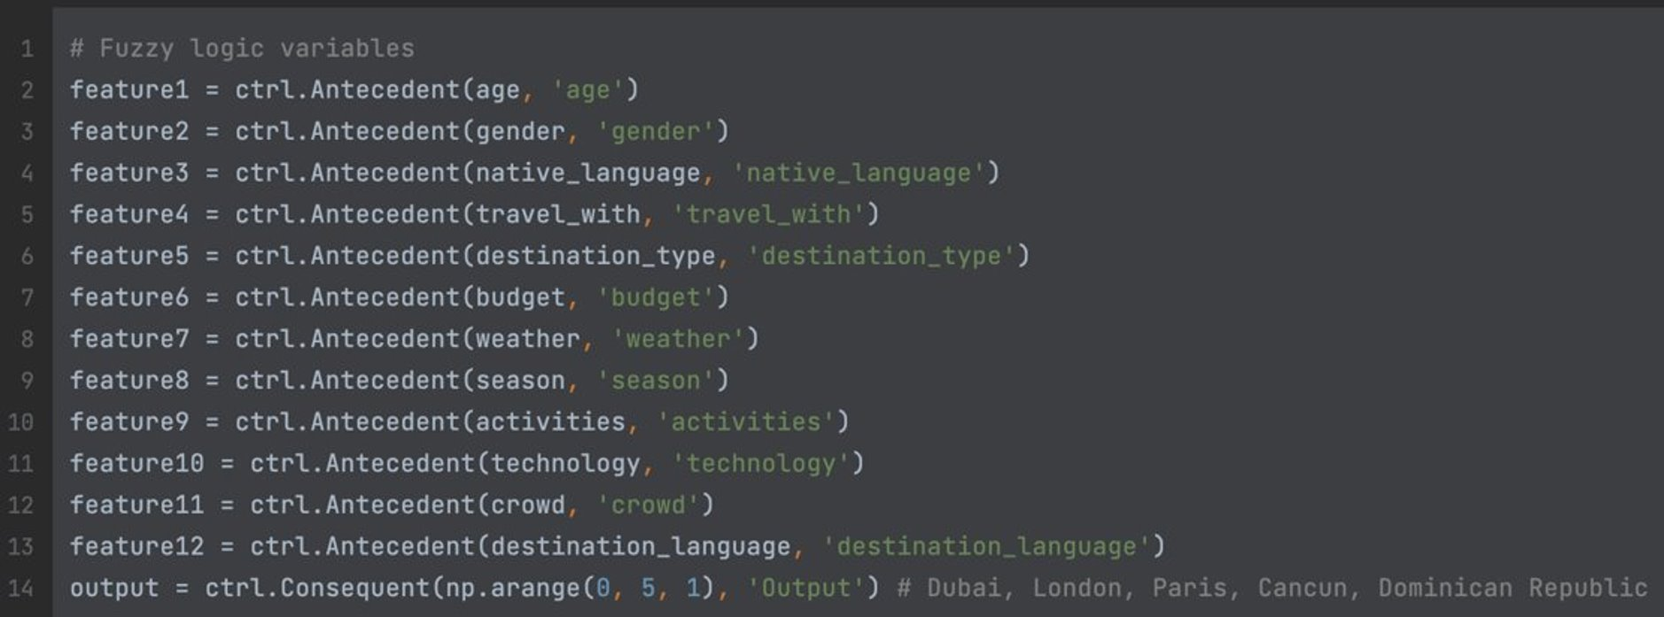
Defining the features

Slide 12
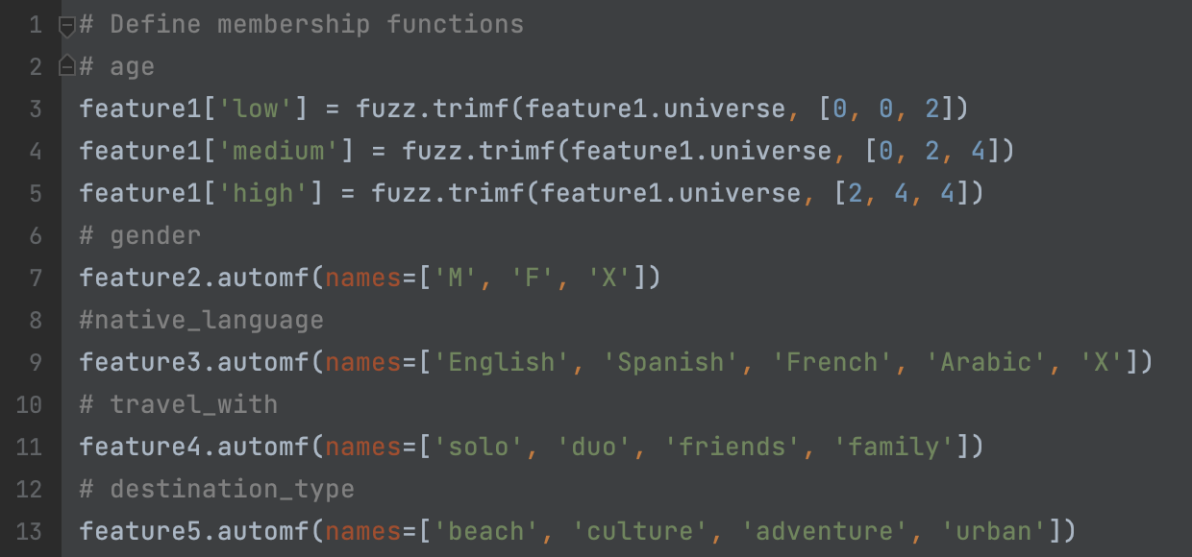
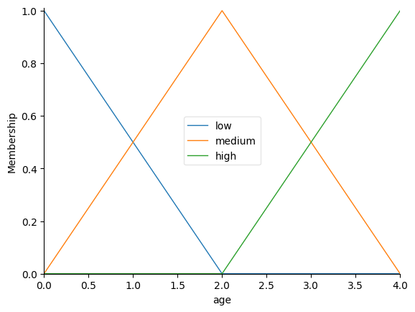
Defining the Membership Functions
...

Slide 13
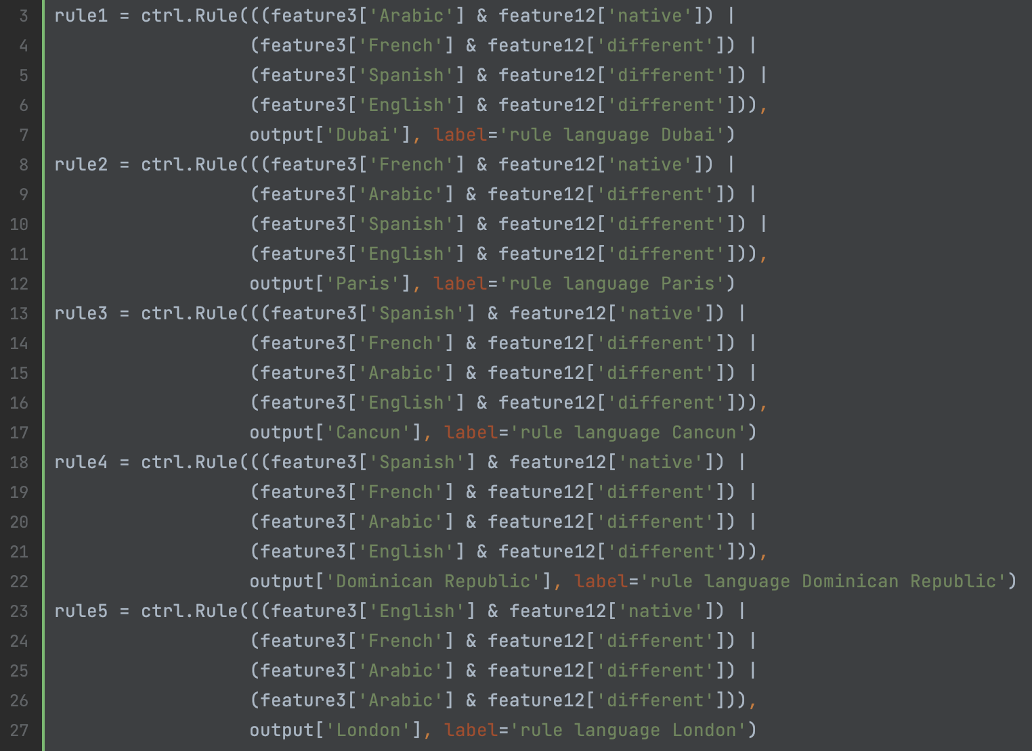
Fuzzy rules

Slide 14

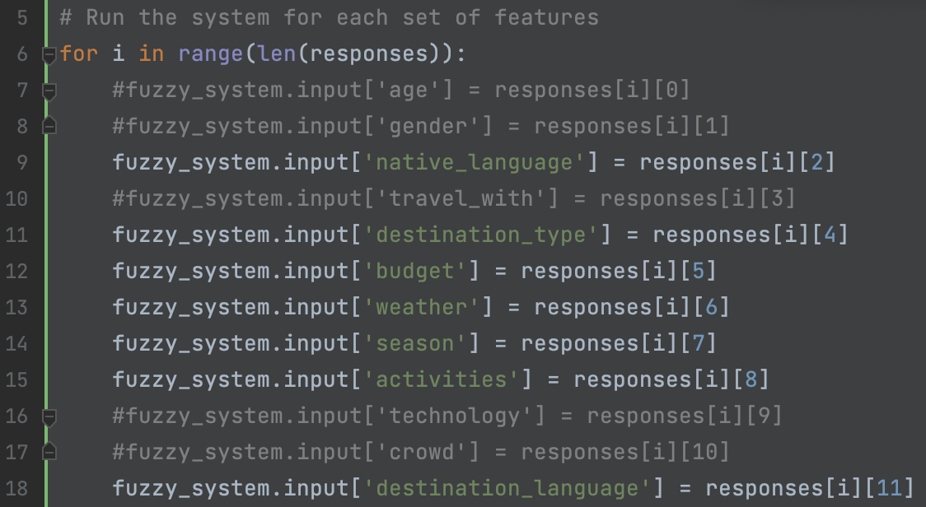
Fuzzy Output

Slide 15
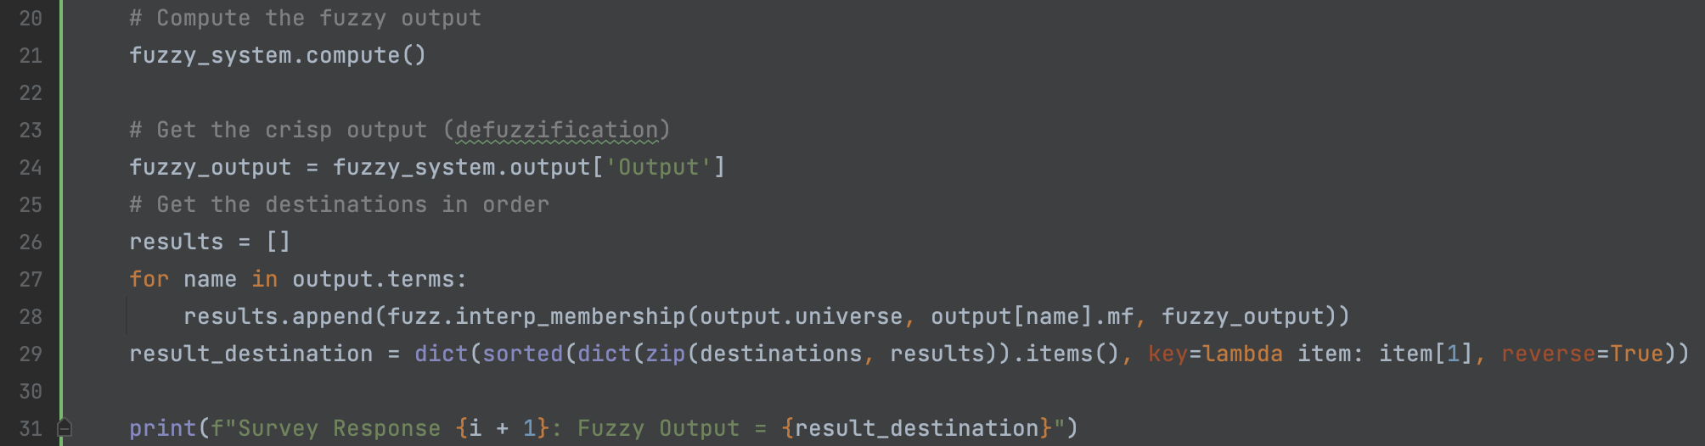
Fuzzy Output

Slide 16
Helps travellers with limited budgets find affordable destinations.
Makes dream trips possible for those on a tight budget.
Introduces frequent travellers to new and exciting destinations.
Encourages exploration beyond familiar places.
Eases the process of finding destinations that everyone in a group will enjoy.
Reduces the hassle of group travel planning.
Conclusion

Slide 17
Add more rules and destinations
User feedback Integration for continuous improvement of recommended locations.
Using fuzzy sets to Adjust to real-time changes such as weather or events in the nearby destination.
Future work

Slide 18
Demo

Slide 19
Thank you

